Slide 1









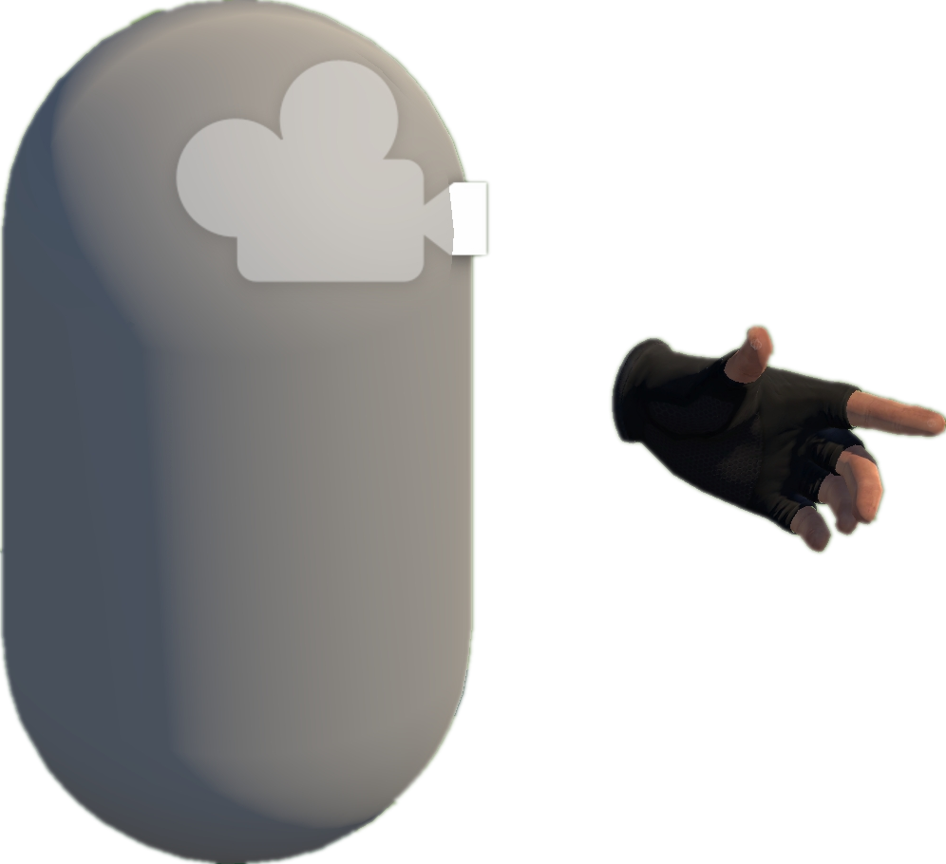


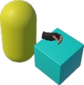



Heuristic rules & experiences
A
Project Collection
& Analysis (§ III-A)
Environment
B
Model Abstraction (§ III-B)
Static Analysis
Interactables
Dynamic Analysis
S1. Scene/prefab scan
Box
D1. Runtime state observation
Heuristic rules & experiences
Collect by Tags
D2. Interaction flow tracing
S2. Script binding extraction
Open Source
Repositories
Unity-based
VR Projects
Abstract Models
S3. Interaction pattern identification
D3. Heuristic validation of task logic
Extract
abstraction models
C
EAT Framework (§ III-C)
D
VRExplorer Testing (§ III-D)
Behavior Execution and Scene Exploration
3
Task Generator & Customized Task Model
Preliminary Scene Configuration
Implementation Interface
Camera
1
2
Hand Controller
Parallel and serial combinations
Grab-And-Drag-Box Task
Base Action
Original Scene
Full Project
Collider
Parallel Action
Inherit
Inherit
VRExplorer Agent
Move to Approcach
Move Action
Grab Action
Grab Action
Trigger Action
Core Scripts
Bake NavMesh
Interaction & Scene Analysis
Grab
Move Action
Autonomous Event Invocation
Grab
Base Entity
Trigger
Customizing Entity Interface Configuration
PFSM
Task Execution
Walk Around
Asynchronous Action
Inherit
Inherit
Decision Making
Decision Making
Grabbable Entity
Triggerable Entity
Scene with NavMesh (for navigation)
Scripts Implemented
Entity Interface
Task Execution
Autonomous
Event Invocation
Implement
Implement
Implement
Input Next Interactable
Output
XR Box
XR Joystick
Task Generator
Task Model
XR Button
Abstraction of Actions
Press
Pressing
Task Layer
Action Layer
Entity Layer
Mono Scripts
Unity Scene
Third Plugins
NavMesh Data
Entity Interface
C# Scripts File
GameObjects
Pressed
Trigger Action
+ Triggering Time
+ Triggering() + Triggered()
Pull
Pulling
Relaxed
Fire
Pulling the trigger
Triggered
Abstraction of Interactable Objects
Triggerable
Button, Joystick
Triggerable & Grabbable
Gun, Cigarette Lighter
Grabbable
Box, Coin
Notes:
单击此处添加文本

